Slide 1
Solving Hard Problems
With Neural Networks and AI
Cody Bellamy, Justin Steiner

Slide 2
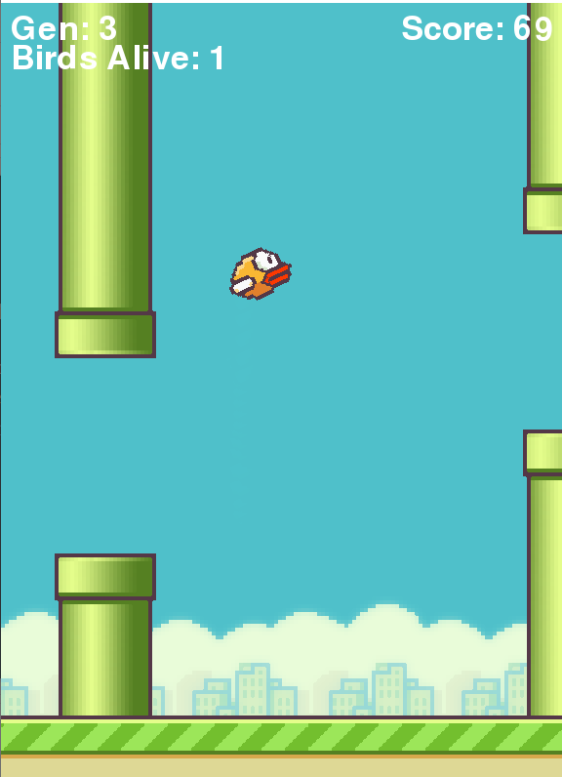

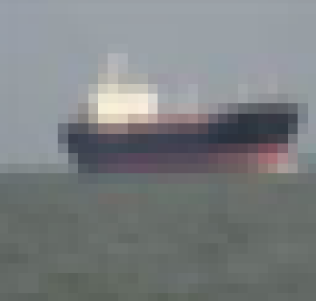


Problem Statements
Youtube Videos - predicting if a video is popular based off other statistics
Digit Recognition - classifying pictures of handwritten numbers
Game playing - creating a program to play Flappy Bird perfectly
Maze solving - creating a program to solve a maze
Computer Vision - locating and classifying boats as they move in the water

Slide 3
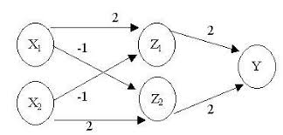
Neural Networks
Each arc has a weight
Each node’s output needs to be within a known range (activation functions)
Notes:
Picture: http://www.ijettjournal.org/2017/volume-45/number-2/IJETT-V45P212.pdf

Slide 4
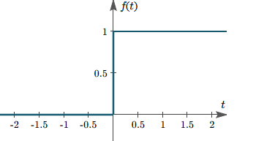
Activation Functions
Step Function
Outputs to 0 or 1
There are other kinds of functions
Notes:
Pictures: https://study.com/academy/answer/write-the-function-in-terms-of-unit-step-functions-find-the-laplace-transform-of-the-rectangular-pulse-function.html

Slide 5
Our Problem
We don’t know which weights will be the best for our networks
So how do we choose them?
We choose random weights
Then optimize them using an optimization algorithm

Slide 6
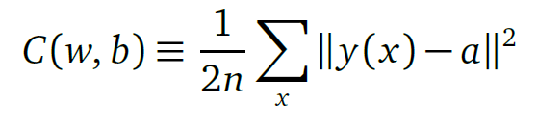
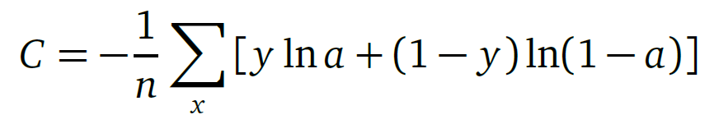
Cost Functions
We need to define what success looks like
Our cost is how poorly our network is performing
High cost = bad network
Low cost = good network
We can optimize our cost

Slide 7
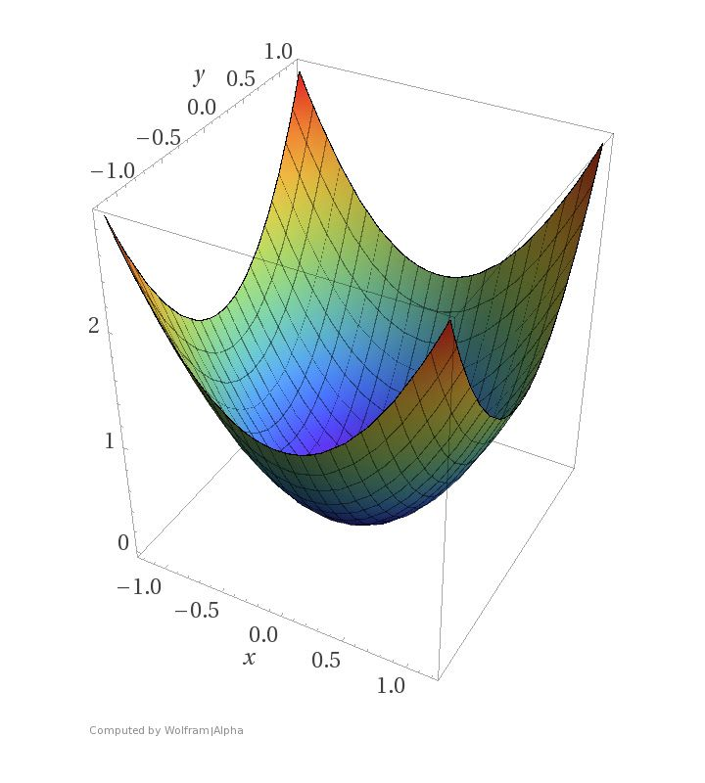
Gradient Descent
Graphing our cost function
X and Y are our weights
Z is our cost
Most likely starting out towards the edges where error is high
Goal is to take small, fast steps towards the minimum of our function
Notes:
Picture: https://blog.paperspace.com/intro-to-optimization-in-deep-learning-gradient-descent/

Slide 8
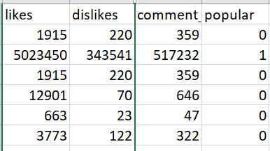
Youtube Video Analysis
Predicting if a youtube video is popular
35.6 thousand data points
86% success rate predicting popularity based on likes, dislikes, and comments
Notes:
Picture: https://www.youtube.com/about/brand-resources/#logos-icons-colors

Slide 9
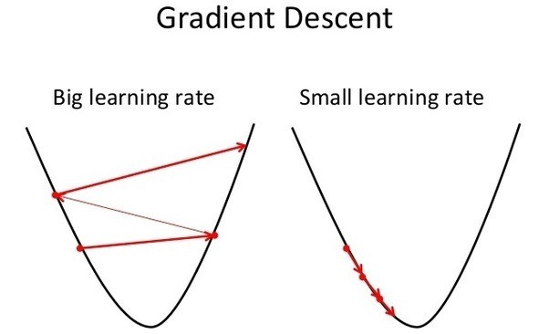
Lessons Learned
Know what your hyper parameters do
Learning rate -> small steps
Batch size -> fast
Number of epochs -> number of steps to take
Apply transformations and experiment with data
Experiment with different optimization algorithms
Notes:
Picture: https://medium.com/@hariprasad0994/interesting-deep-learning-techniques-lr-366f013d959a

Slide 10
Training Sets Vs Test Sets
Training Set
Used to create our model
Contains most of our data
Test Set
Used to see how well our model is doing
Splitting up the data into a training and test set helps to prevent a network from memorizing data and getting a 100% success rate

Slide 11
Digit Recognition
Classifying what number an image is
60,000 data points in the training set
10,000 data points in the test set
28x28 image
Interpreted as 784 integers from 0 to 255
1 variable corresponding to the digit’s label
0-9
97% success rate
Notes:
Picture: https://kx.com/blog/kxcon2016-puzzle-challenge/

Slide 12
Lessons Learned
Sometimes you need to do things by hand
Take breaks, step back and look with fresh eyes
Libraries are only powerful if you know how they work

Slide 13
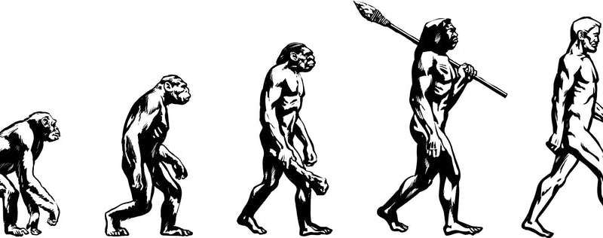
Genetic Algorithms
Based off Evolution
Start off very primitive, gets very advanced
Notes:
Picture: https://phys.org/news/2019-09-evolution-doesnt-proceed-straight-line.html

Slide 14
Genetic Algorithms
Creating a perfect Flappy Bird playing program
Creates population of Neural Network Objects
Initial population acts randomly
Calculate how well each instance of the network is doing based on a ‘fitness’ score
Take the most fit and have them as the ‘parents’ for the next generation
Mutate the ‘children’ of the generation and repeat

Slide 15
Lessons Learned
Don’t be discouraged by intermittent bugs
Take baby steps towards your end goal
Libraries can be very useful

Slide 16
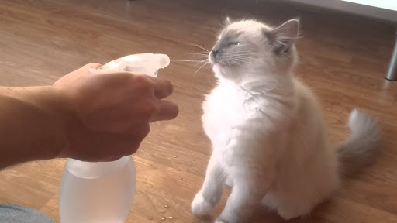
Reinforcement Learning
Based on “Carrots and Sticks” or “Rewards and Punishments”
Stores “reward” as a number and seeks to maximize reward
Notes:
Picture: http://takomatorch.com/index.php/2019/07/13/takoma-park-police-adopt-new-enforcement-tactic-based-on-cat-discipline/

Slide 17
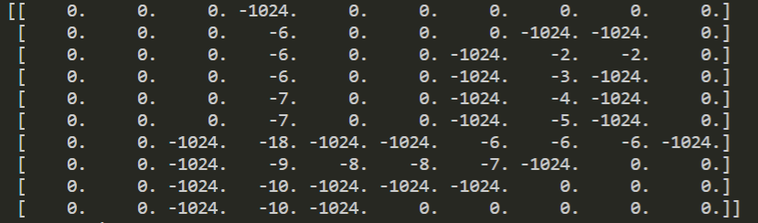
Reinforcement Learning
Set up a reward function and a means to store it
Does not have to be continuous
For any given action, generate a reward (negative rewards are considered punishments) and store it within the network

Slide 18
Lessons Learned
Understand the big picture of your project
Break up your project into smaller problems
It’s ok to get a specific solution, and then generalize it

Slide 19
Future Goals
Computer Vision and object detection
Being able to classify and locate different types of things in a picture
Our goal is to classify boats on the water

Slide 20
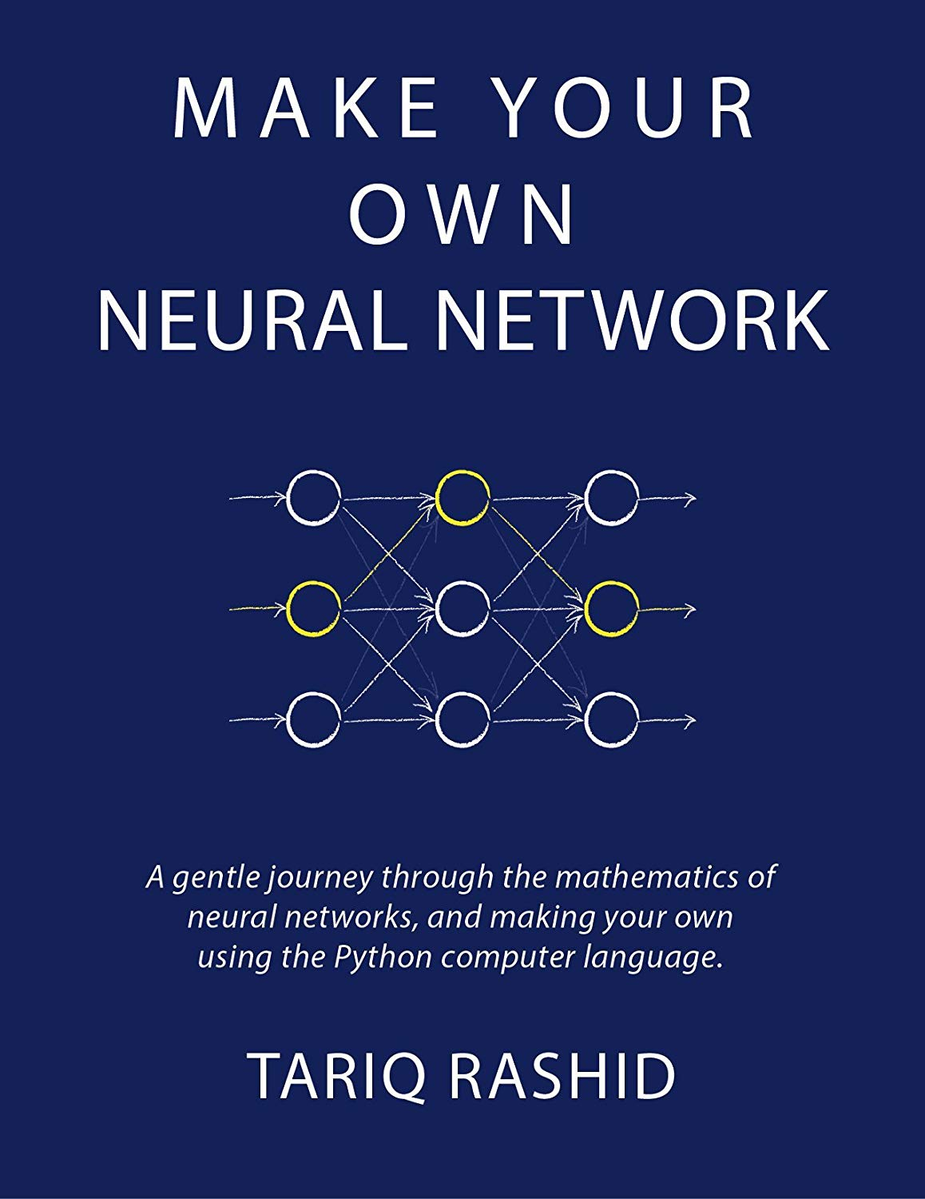
You Can Do this Too!!!!
Any Questions?
Notes:
Picture: https://www.amazon.com/Make-Your-Own-Neural-Network-ebook/dp/B01EER4Z4G

